Slide 1

WIRELESS NETWORK THREATS AND MEASURES
PRESENTED BY:-
NIVEDITA BHATIA -05
PRATAP CHAVAN -10
JAYADEV NAIR -32
SIDDHI VAIDYA -55

Slide 2

Wireless Network
Wireless network is a wireless communication between two interconnect nodes without the use of wires. Mobility lifts the requirement for a fixed point of connection to the network which allows users to move physically while using their devices.

Slide 3
Wireless Network
Types of Wireless Networks:-
Wireless Local Area Networks (WLAN)
2. Wireless Wide Area Networks (WWAN)
3. Wireless Metropolitan Area Networks (WMAN)

Slide 4
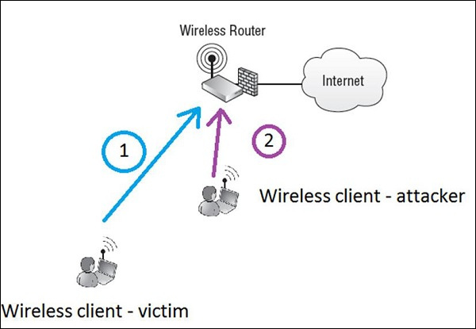

Slide 5
Threats in Wireless Networks

Slide 6
Accidental Association
Unauthorized access to company wireless and wired networks can come from a number of different methods and intents. One of these methods is referred to as “accidental association”.

Slide 7
Malicious Association
Malicious associations” are when wireless devices can be actively made by crackers to connect to a company network through their cracking laptop instead of a company access point (AP).

Slide 8
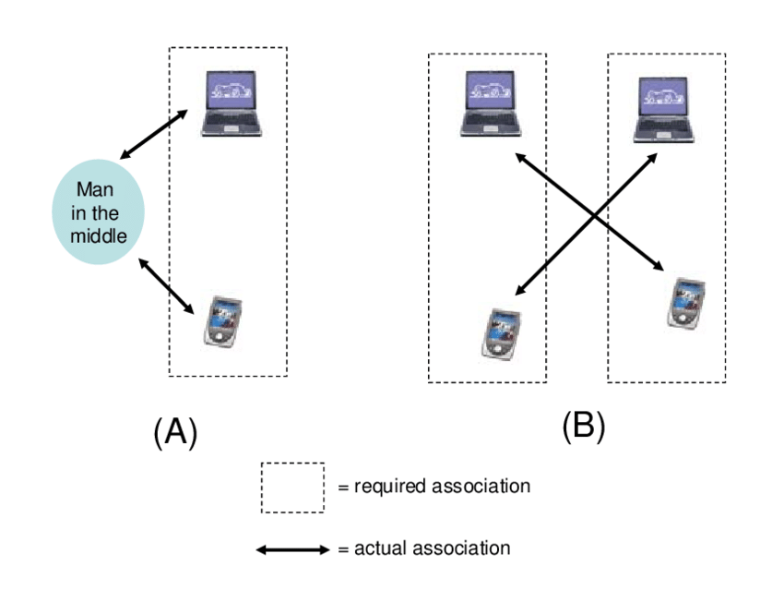

Slide 9
What is Ad Hoc Network?
A wireless Ad hoc netwrok is a netwrok which is used to exchange information
Each node is willing to forward data to other nodes
Doesnt rely on a fixed infrastucture

Slide 10
Features of Ad Hoc Network
Free Terminal
Distributed operations
Multi hop routing
Light weight terminal
Dynamic toplogy

Slide 11
Overview
Security is an essential requirement in wireless ad hoc networks
Compared to wired networks, WANET are more threatened and penetrable to security attacks due to lack of trusted centralized authoriy and limited resources

Slide 12
Applications
Personal area network
Militiary environment
Civilian environment
Emergency operations

Slide 13
Why Ad-Hoc Network ?
Ease of development
Speed of development
Decreased dependence of infrastructure

Slide 14
Challenges
Security concerns
Real time services
Authentication and accounting

Slide 15
Security requirements in WANETs
Five major security goals that need to be addressed in order to maintain a reliable and secure ad hoc network environment
They are mainly
Confidentiality
Availability
Integrity
Authenticity
Non repudiation
Detection and isolation

Slide 16
General objectives of attacks
Increase attacker control over the communications between some nodes
Degrade the duality of the service provided by the network
Increase the resource consumption of some nodes

Slide 17
Mac spoofing
What is mac address ?
It is a universal unique address
but it is possible to change the mac address today.

Slide 18
Identifying Mac Spoofing Attacks
What are the possible examples of mac spoofing attacks ?
Identity theft
Read the packets which are intended for someone else
Inject malicious packets to reveal some secretes
Useful to bypass IPMAC mapping tables
Bypass mac firewall

Slide 19
Man in middle attack
Man-in-the-middle attacks (MITM) are a common type of cybersecurity attack that allows attackers to eavesdrop on the communication between two targets.
TYPES OF ATTACKS
1.Rogue Access Point
2.ARP Spoofing
3.mDNS Spoofing
4.DNS Spoofing

Slide 20
Man in middle attack
Man-in-the-middle attack techniques
Sniffing
Packet Injection
Session hijacking
SSL stripping
Practices to prevent man in middle attack
1.Strong WEP/WAP Encryption on Access Points
2.Strong Router Login Credentials
3.Virtual Private Network
4.Force HTTPS
5.Public Key Pair Based Authentication

Slide 21
Denial of service
How a DoS attack works
A DoS attack prevents users from accessing a service by overwhelming either its physical resources or network connections. The attack essentially floods the service with so much traffic or data that no-one else can use it until the malicious flow has been handled.

Slide 22
Denial of service
DoS attack used for profit
There have been numerous cases of DoS attacks being launched for personal reasons — a grunge against a user, the service, or just pure mischief. Services under attack can be slowed or crashed for periods ranging from a few hours to a couple days.

Slide 23
Denial of service
Defending against a DoS attack
Launching a DoS attack used to require a certain level of technical knowledge and ability. This tended to limit their use to people who were skilled, or were able to find and hire someone with the necessary skills.

Slide 24
Network injection
During an injection attack, an attacker can provide malicious input to a web application (inject it) and change the operation of the application by forcing it to execute certain commands.
Types of injection attacks
1. SQL Injection (SQLi)
2.Cross-Site Scripting (XSS)
3.Code Injection
4.Command Injection
5.CCS Injection

Slide 25
Types of wireless security measures
1. Securing wireless transmission
2. Securing wireless access points
3. Securing wireless networks

Slide 26
Securing wireless transmission
1. Signal hiding techniques
Turning off service set identifier (SSID)
Assigning cryptic names to SSIDs
Reducing signal strength to the lowest level
Placing the wireless access points in the interiors of a building
Using directional antennas and signal shielding techniques

Slide 27
Securing wireless transmission
2. Encryption
WEP
WPA
WPA2
WPA enterprise

Slide 28
Securing wireless access points
Using IEEE 802.1x standard for port-based network access control
It provides an authentication mechanism
It prevents rogue access points and other unauthorized devices from becoming insecure backdoors

Slide 29
Securing wireless networks
Using encryption
Using Firewalls, antivirus and antispyware software
Turning of identifier broadcasting
Changing the identifier form default
Changing default password to some custom password
Allowing only specific computers to access your wireless network
·

Slide 30
Thank you

